Slide 1
Percent growth in online enrollments face-to-face vs completely online courses (designated100%) at CCC
+ 475%
100% online
Face-to-face
- 19%
Source: CCCCO Data Mart. Enrollment in Distance Education Credit Courses.
Notes:
Course instruction groups: 1) Non distance education methods; 2) Internet-based includes simultaneous and delayed interaction internet-based distance education methods; 3) Other distance eduaction methods include one-way and/or two-way interactive audio/video and other simultaneous interactive or passive mediums

Slide 2
Ten year trend in CCC online participation rates
12%
2%
Source: CCCCO Data Mart. Enrollment in Distance Education Credit Courses.
Notes:
Course instruction groups: 1) Non distance education methods; 2) Internet-based includes simultaneous and delayed interaction internet-based distance education methods; 3) Other distance eduaction methods include one-way and/or two-way interactive audio/video and other simultaneous interactive or passive mediums

Slide 3
Participation rates for online course by student ethnicity
16%
13%
12%
10%
Source: CCCCO Data Mart. Enrollment in Distance Education Credit Courses.
Notes:
Course instruction groups: 1) Non distance education methods; 2) Internet-based includes simultaneous and delayed interaction internet-based distance education methods; 3) Other distance eduaction methods include one-way and/or two-way interactive audio/video and other simultaneous interactive or passive mediums

Slide 4
Participation rates for online course by student gender
14%
9%
Source: CCCCO Data Mart. Enrollment in Distance Education Credit Courses.
Notes:
Course instruction groups: 1) Non distance education methods; 2) Internet-based includes simultaneous and delayed interaction internet-based distance education methods; 3) Other distance eduaction methods include one-way and/or two-way interactive audio/video and other simultaneous interactive or passive mediums

Slide 5
Participation rates for online course by student age group
Less than 25 Years Old
25+ Years Old
+ 13%
+ 10%
Source: CCCCO Data Mart. Enrollment in Distance Education Credit Courses.
Notes:
Course instruction groups: 1) Non distance education methods; 2) Internet-based includes simultaneous and delayed interaction internet-based distance education methods; 3) Other distance eduaction methods include one-way and/or two-way interactive audio/video and other simultaneous interactive or passive mediums

Slide 6
Participation rates using a more detailed view of student age
The 25 to 39 age group is experiencing the fastest growth rate
+ 18%
+ 14%
Recent High School grads enroll in online courses to a lesser degree than older students
+ 9%
+ 7%
Source: CCCCO Data Mart. Enrollment in Distance Education Credit Courses.
Notes:
Course instruction groups: 1) Non distance education methods; 2) Internet-based includes simultaneous and delayed interaction internet-based distance education methods; 3) Other distance eduaction methods include one-way and/or two-way interactive audio/video and other simultaneous interactive or passive mediums

Slide 7
Summary of participation rates for CCC online courses
Percentage of courses enrolled that were online (2016/17)
Student Ethnicity
African-American
Asian
Hispanic
White
Student Age Group
Less than 25 Years old
25+ Years old
Student Gender
Female
Male
13 %
12 %
10 %
16 %
10 %
13 %
14 %
9 %
The cohorts exhibiting the highest participation rates are consistent with those found in the statewide report
Between 2006/07 and 2016/17 online participation rates have increased for every student demographic category within ethnicity, age and gender

Slide 8
Ten year trend in online performance gap
(percentage point difference in course success rates, online minus face-to-face)
The course pass rate for online courses in 2007/08 was 19.9 percentage points lower than those taking face-to-face course
-8.2%
By 2016/17 the success rate gap shrunk by half to 7.3 percentage points
-19.9%
Source: CCCCO Data Mart. Enrollment in Distance Education Credit Courses.
Notes:
Course instruction groups: 1) Non distance education methods; 2) Internet-based includes simultaneous and delayed interaction internet-based distance education methods; 3) Other distance eduaction methods include one-way and/or two-way interactive audio/video and other simultaneous interactive or passive mediums

Slide 9
Ten year trend in online performance gap
(percentage point difference in course success rates, online minus face-to-face)
- 3.4%
- 7.4%
- 7.5%
- 16.9%
- 17.5%
- 15.7%
- 20.1%
- 27.8%
Source: CCCCO Data Mart. Enrollment in Distance Education Credit Courses.
Notes:
Course instruction groups: 1) Non distance education methods; 2) Internet-based includes simultaneous and delayed interaction internet-based distance education methods; 3) Other distance eduaction methods include one-way and/or two-way interactive audio/video and other simultaneous interactive or passive mediums

Slide 10
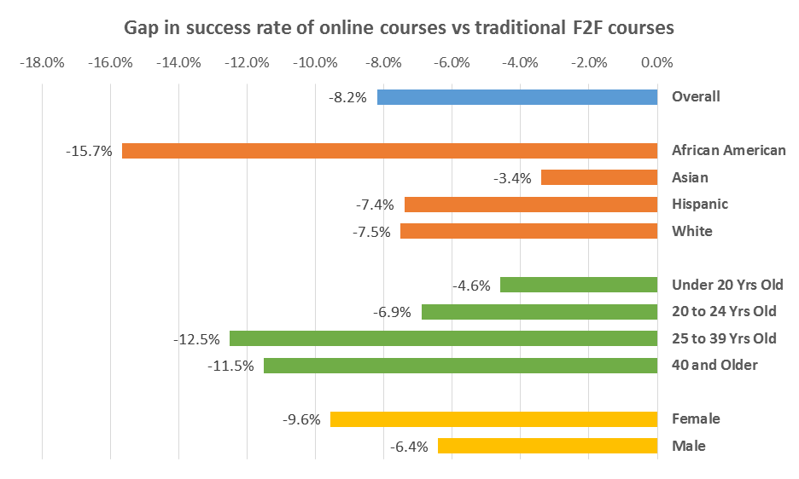
Online success rates are lower than face-to-face success rates for every student demographic
CCC's overall performance gap of 8.2% is higher than the statewide average of 6.9%.
Paralleling the state level findings, CCC’s African Americans are experiencing the largest performance gaps.
The state report found that students under the age of 25 had a larger performance gap than those 25 and over. That is not true at CCC.
Where we diverge from the state findings is in having our female students experience a larger gap in course success rates than males.
Source: CCCCO Data Mart. Enrollment in Distance Education Credit Courses.
Notes:
Course instruction groups: 1) Non distance education methods; 2) Internet-based includes simultaneous and delayed interaction internet-based distance education methods; 3) Other distance eduaction methods include one-way and/or two-way interactive audio/video and other simultaneous interactive or passive mediums

